Slide 1
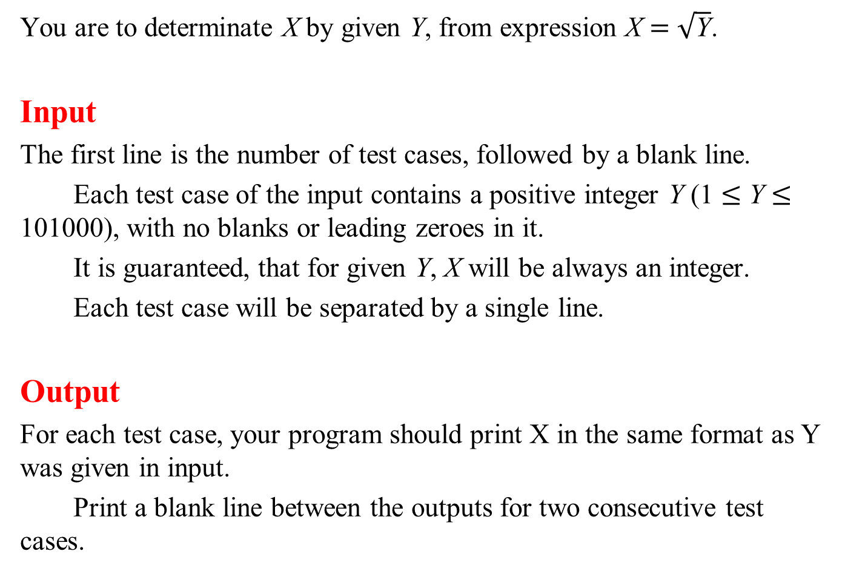
You are to determinate X by given Y, from expression X = $\sqrt{\text{Y}}$.
Input
The first line is the number of test cases, followed by a blank line.
Each test case of the input contains a positive integer Y (1 ≤ Y ≤ 101000), with no blanks or leading zeroes in it.
It is guaranteed, that for given Y, X will be always an integer.
Each test case will be separated by a single line.
Output
For each test case, your program should print X in the same format as Y was given in input.
Print a blank line between the outputs for two consecutive test cases.

Slide 2
Sample Input
1
7206604678144
Sample Output
2684512

Slide 3
template< typename T >
HugeInteger< T >::HugeInteger( string str )
{
value_type digits[ 1001 ] = {};
size_type last = str.size() - 1;
for( size_type i = 0; i <= last; ++i )
digits[ i ] = static_cast< value_type >( str[ last - i ] ) - '0';
size_type numDigits = sizeof( value_type ) - 1;
for( size_type i = 0; i <= last; i += numDigits )
{
value_type bigDigit = digits[ i ] +
digits[ i + 1 ] * 10 +
digits[ i + 2 ] * 100 +
digits[ i + 3 ] * 1000 +
digits[ i + 4 ] * 10000 +
digits[ i + 5 ] * 100000 +
digits[ i + 6 ] * 1000000;
integer.push_back( bigDigit );
}
}

Slide 4
template< typename T1, typename T2 >
void solution()
{
int numCases;
cin >> numCases;
for( int i = 1; i <= numCases; ++i )
{
string str;
cin >> str;
HugeInteger< T1 > hugeInteger( str );
cout << hugeInteger.squareRoot() << endl;
if( i < numCases )
cout << endl;
}
}

Slide 5
 | 0 | 1 | 2 | 3 | 4 | 5 | 6 | 7 | 8 | 9 | 10 | 11 | 12 | 13
string | 7 | 2 | 0 | 6 | 6 | 0 | 4 | 6 | 7 | 8 | 1 | 4 | 4 | \0
 | 0 | 1 | 2 | 3 | 4 | 5 | 6 | 7 | 8 | 9 | 10 | 11 | 12 | 13
int | 4 | 4 | 1 | 8 | 7 | 6 | 4 | 0 | 6 | 6 | 0 | 2 | 7
0
0
0
hugeInteger
myEnd
myLast
myFirst
myData
integer

Slide 6
 | 0 | 1 | 2 | 3 | 4 | 5 | 6 | 7 | 8 | 9 | 10 | 11 | 12 | 13
string | 7 | 2 | 0 | 6 | 6 | 0 | 4 | 6 | 7 | 8 | 1 | 4 | 4 | \0
 | 13 | 12 | 11 | 10 | 9 | 8 | 7 | 6 | 5 | 4 | 3 | 2 | 1 | 0
int |  | 7 | 2 | 0 | 6 | 6 | 0 | 4 | 6 | 7 | 8 | 1 | 4 | 4
0
0
0
hugeInteger
myEnd
myLast
myFirst
myData
integer

Slide 7
 | 0 | 1 | 2 | 3 | 4 | 5 | 6 | 7 | 8 | 9 | 10 | 11 | 12 | 13
string | 7 | 2 | 0 | 6 | 6 | 0 | 4 | 6 | 7 | 8 | 1 | 4 | 4 | \0
 | 13 | 12 | 11 | 10 | 9 | 8 | 7 | 6 | 5 | 4 | 3 | 2 | 1 | 0
int |  | 7 | 2 | 0 | 6 | 6 | 0 | 4 | 6 | 7 | 8 | 1 | 4 | 4
1 | 0
720660 | 4678144
0
0
0
hugeInteger
myEnd
myLast
myFirst
myData
integer

Slide 8
Square Root
 | 1 | 0
hugeInt | 720660 | 4678144
 | 0
sqrt
low | 0
high | 9999999
 | 1 | 0
square

Slide 9
Square Root
 | 1 | 0
hugeInt | 720660 | 4678144
 | 0
sqrt | 4999999
low | 0
high | 9999999
 | 1 | 0
square

Slide 10
Square Root
 | 1 | 0
hugeInt | 720660 | 4678144
 | 0
sqrt | 4999999
low | 0
high | 9999999
 | 1 | 0
square | 2499999 | 0000001

Slide 11
Square Root
 | 1 | 0
hugeInt | 720660 | 4678144
 | 0
sqrt | 4999999
low | 0
high | 4999998
 | 1 | 0
square | 2499999 | 0000001

Slide 12
Square Root
 | 1 | 0
hugeInt | 720660 | 4678144
 | 0
sqrt | 2499999
low | 0
high | 4999998
 | 1 | 0
square | 2499999 | 0000001

Slide 13
Square Root
 | 1 | 0
hugeInt | 720660 | 4678144
 | 0
sqrt | 2499999
low | 0
high | 4999998
 | 1 | 0
square | 6249995 | 0000001

Slide 14
Square Root
 | 1 | 0
hugeInt | 720660 | 4678144
 | 0
sqrt | 2499999
low | 2500000
high | 4999998
 | 1 | 0
square | 6249995 | 0000001

Slide 15
Square Root
 | 1 | 0
hugeInt | 720660 | 4678144
 | 0
sqrt | 3749999
low | 2500000
high | 4999998
 | 1 | 0
square | 6249995 | 0000001

Slide 16
Square Root
 | 1 | 0
hugeInt | 720660 | 4678144
 | 0
sqrt | 3749999
low | 2500000
high | 4999998
 | 1 | 0
square | 1406249 | 2500001

Slide 17
Square Root
 | 1 | 0
hugeInt | 720660 | 4678144
 | 0
sqrt | 3749999
low | 2500000
high | 3749998
 | 1 | 0
square | 1406249 | 2500001

Slide 19
Square
 | 1 | 0
hugeInt | 720660 | 4678144
 | 3 | 2 | 1 | 0
square |  |  | 3371351255040 | 21885031284736

Slide 20
Square
 | 1 | 0
hugeInt | 720660 | 4678144
 | 3 | 2 | 1 | 0
square |  | 519350835600 | 6742702510080 | 21885031284736

Slide 21
Square
 | 1 | 0
hugeInt | 720660 | 4678144
 | 3 | 2 | 1 | 0
square |  | 519350835600 | 6742704698583 | 1284736

Slide 22
Square
 | 1 | 0
hugeInt | 720660 | 4678144
 | 3 | 2 | 1 | 0
square |  | 519351509870 | 4698583 | 1284736

Slide 23
Square
 | 1 | 0
hugeInt | 720660 | 4678144
 | 3 | 2 | 1 | 0
square | 51935 | 1509870 | 4698583 | 1284736

